Slide 1


Department of BES1
Data structures
24SC1203
Topic:
Queue using linked list
Session – 14

Slide 2



AIM OF THE SESSION
To familiarize students with the basic concept of Single Linked list
INSTRUCTIONAL OBJECTIVES
This Session is designed to:
Demonstrate Queue using Singly Linked list .
Describe the operations on Queues.
Describe the Applications.
List out Real time Examples.
LEARNING OUTCOMES
At the end of this session, you should be able to:
Define Queue
Describe Queue operations using Single Linked List.
Summarize Queue operations

Slide 3


Queue using Single Linked List
Queue ?
It is a linear data structure where insertion is done at rear end, deletion and retrieval of data is done from front end.
FIRST IN FIRST OUT

Slide 4
Real-Time Examples:
Real-Time Examples:
People moving on an escalator.
People waiting for a bus
People standing outside the ticketing window of a cinema hall.
Luggage kept on conveyor belts.
Cars lined at a toll bridge

Slide 5
Applications:
Applications:
Queues are used in operating system for handling interrupts.
Queues are used as buffers on MP3 players and portable CD players, iPod playlist.
Queues are widely used as waiting lists for a single shared resource like printer, disk, CPU.
Queues are used in Playlist for jukebox to add songs to the end, play from the front of the

Slide 6
Operations
ENQUEUE(Insertion)
DEQUEUE(Deletion)
DISPLAY

Slide 7
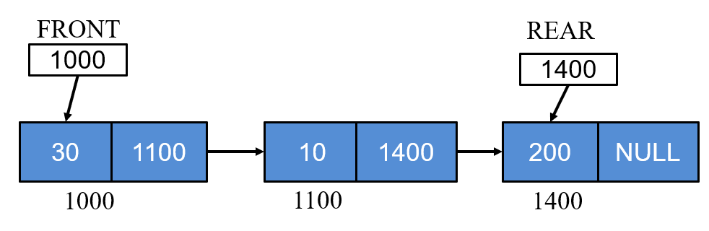
Linked List Representation of QUEUE
Operations
Two special pointers
  Front
  Rear

Slide 8
Representation
Every node has two parts:
  Stores data
  Stores the address of next node.
struct Node
{
int data;
struct Node *next;
} *front,*rear;

Slide 9
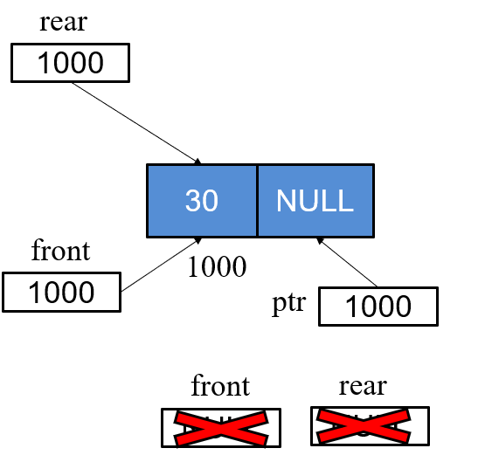
Operations :Enqueue
Step 1: Allocate memory for the new node and name it as PTR
Step 2: SET PTR-> DATA = VAL
Step 3: IF FRONT = NULL
SET FRONT=REAR=PTR
SET FRONT->NEXT = REAR-> NEXT = NULL
ELSE
SET REAR->NEXT = PTR
SET REAR = PTR
SET REAR->NEXT =NULL
[END OF IF]
Step 4: END
SET REAR

Slide 10
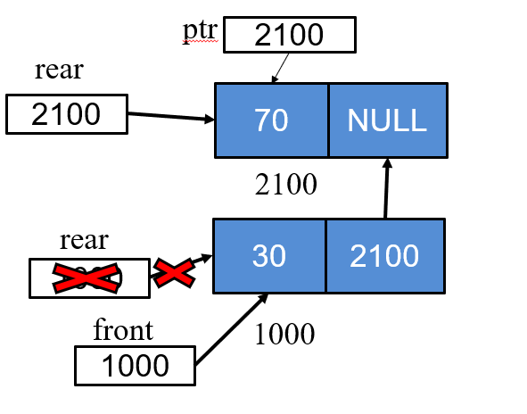
Operations :Enqueue

Slide 11
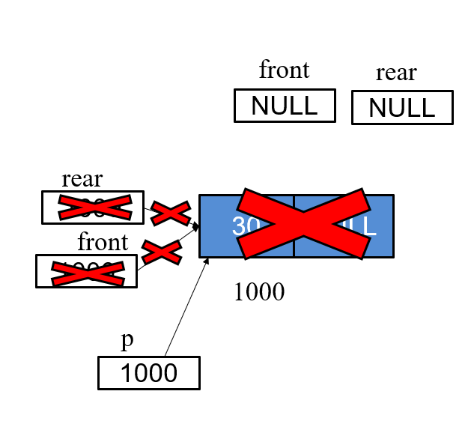
Operations :Dequeue
Step 1: IF FRONT = NULL
Write Underflow
Go to Step 5
[END OF IF]
Step 2: SET PTR = FRONT
Step 3: SET FRONT = FRONT -> NEXT
Step 4: FREE PTR
Step 5: END

Slide 12
Operations :Display
Step 1: Set ptr = q -> front
Step 2: if ptr == NULL
Print QUEUE IS EMPTY
else
repeat step 3 until ptr == q->rear
Step 3: a. Print ptr->data
b. set ptr= ptr->next
Step 4: Print ptr->data
[end if]
Step 5: END

Slide 13
SUMMARY
We learned about:
What is a queue and where it can be implemented
Real time examples
Various operations of Queue

Slide 14
SELF-ASSESSMENT QUESTIONS
In linked list implementation of a queue, where does a new element be inserted?
A) At the head of link list
B) At the Centre position in the link list
C) At the tail of the link list
D) At any position in the linked list
2. In linked list implementation of a queue, front and rear pointers are tracked. Which of these pointers will change during an insertion into EMPTY queue?
(A) Only front pointer
B) Only rear pointer
C) Both front and rear pointer
D) No pointer will be changed

Slide 15
TERMINAL QUESTIONS
Define Queue and write about its importance
List the Real Time Examples for Queues
Where to implement the queues(Applications of Queues)
How many pointers are required in Queues and name them
When underflow condition is existed in Queues
Name the operations that can you perform on Queues
Write the declaration statements of Queues
Distinguish between Stack and Queue
Why you are moving from Stack to Queue
Is there any limitations of Queue
What will be the principle used in Queue
By which you can implement the queue opertaions by using singly or doubly linked list?

Slide 16
REFERENCES FOR FURTHER LEARNING OF THE SESSION
Reference Books:
1. A.v.Aho,J.E.Hopcroft,and J.D.Ullman ,”Data structures And Algorithms”,Pearson Education 1e.
2. “Fundamentals of Data Structures in C”,Horowitz,Sahni,Anderson Freed 2e-2007
3.R.F.Gilberg,B.A.Forouzan,”Data Structures” 2e Thomson India Edition-2007
Sites and Web links:
1. https://nptel.ac.in/courses/106102064
2. https://www.edx.org/course/algorithms -and -data-structures-1
3. https://www.coursera.org/learn/data-structures?action=enroll

Slide 17
THANK YOU
Team – Course Name

